Slide 1

Amazon Wishlist Price Tracker
Intelligent price monitoring powered by AI and automation
Built with n8n, Google Gemini AI, ScrapingBee, Google Sheets, and Gmail
Notes:
1

Slide 2



The Problem: Information Overload
Manual Tracking is Tedious
Shoppers manually check Amazon wishlist items daily, wasting time on repetitive tasks without guaranteed results.
Missing Price Drops
Without automated alerts, critical price reductions go unnoticed, leading to missed savings and buying opportunities.
Poor Decision Making
Shoppers lack intelligent insights to determine whether to buy now or wait for better deals.
Notes:
2

Slide 3
Project Objectives
Automated Monitoring
AI-Powered Insights
Continuously track Amazon wishlist prices without manual intervention.
Leverage Google Gemini to deliver smart Buy/Wait recommendations based on price history and trends.
Intelligent Alerts
Scalable Architecture
Send actionable email summaries with visual charts and personalized recommendations.
Design a flexible, low-cost workflow that handles multiple wishlists and product categories.
Notes:
3

Slide 4
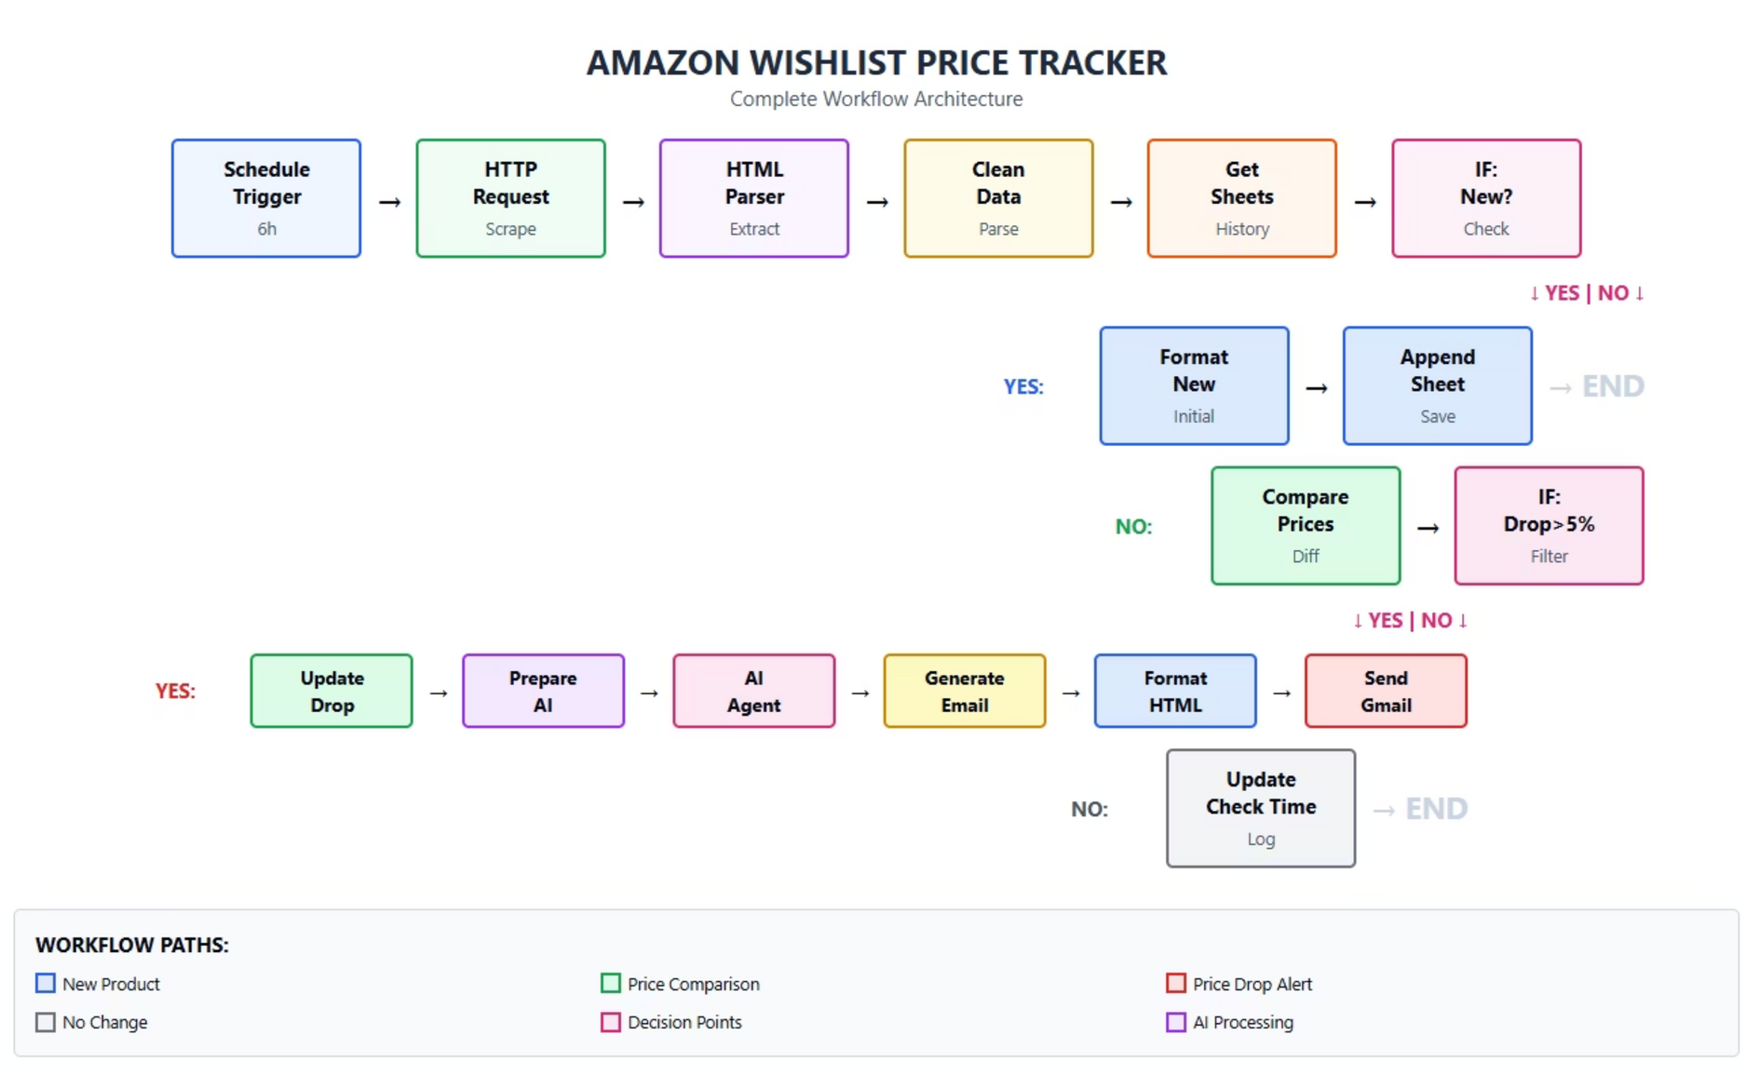
Architecture
Notes:
4

Slide 5
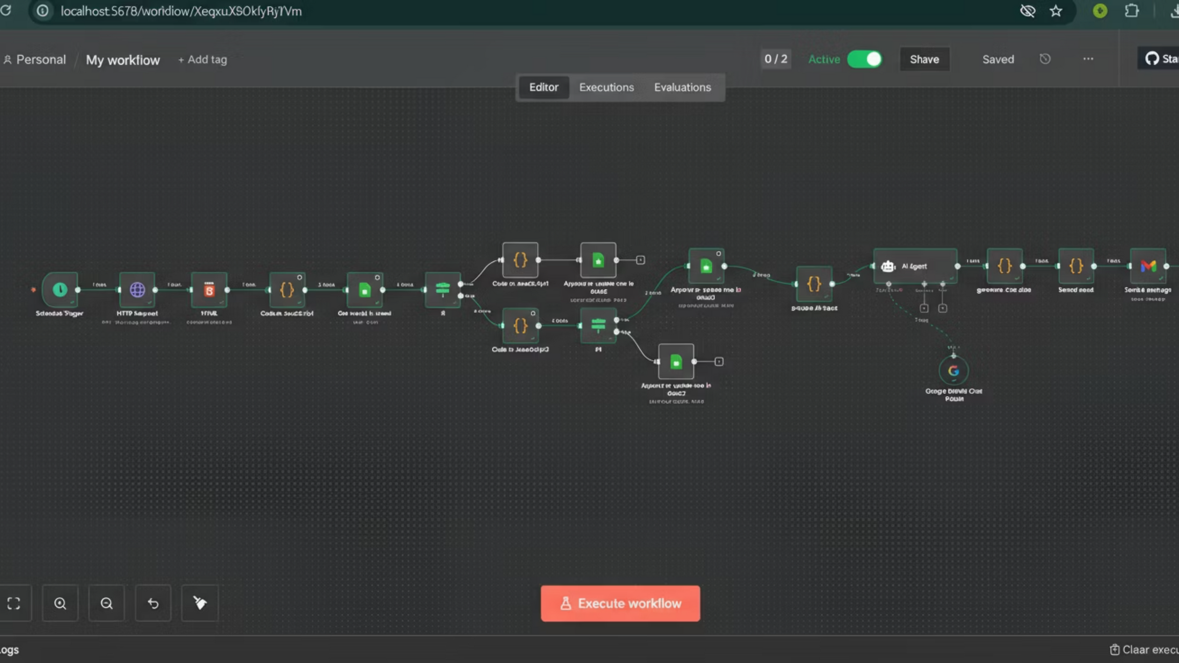
Notes:
5

Slide 6
Key Features
Web Scraping
1
ScrapingBee handles dynamic content extraction from Amazon product pages, bypassing detection and rate limits.
Price History Tracking
2
Google Sheets maintains a timestamped database of all price changes, enabling trend analysis and pattern recognition.
AI Recommendations
3
Gemini evaluates price trends, seasonal patterns, and market conditions to recommend Buy Now or Wait.
Smart Filtering
4
Configurable alerts trigger only for meaningful price drops, reducing notification fatigue.
Visual Reports
5
Emails include embedded charts showing price trends over time with clear insights and confidence levels.
Scheduled Execution
6
Automatic daily or weekly checks ensure constant monitoring without user intervention.
Notes:
6

Slide 7
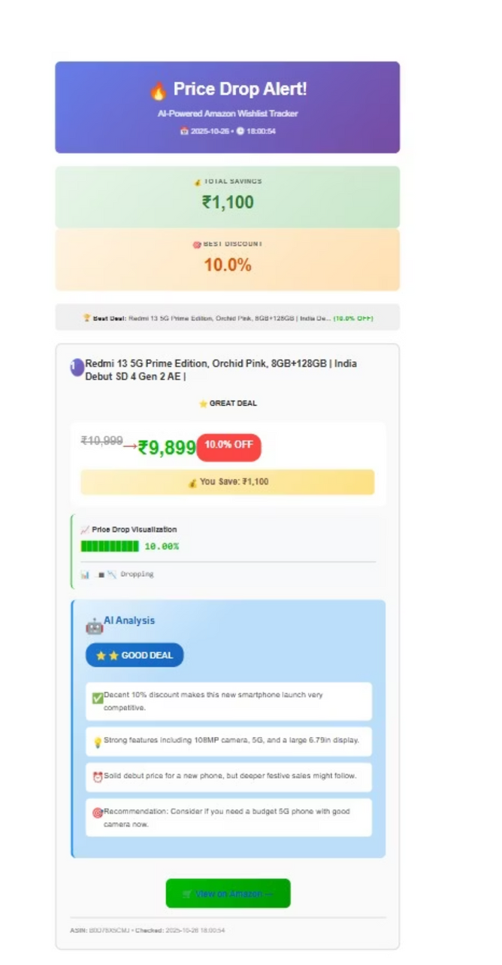
Results/Performance
Notes:
7

Slide 8
How This Project Helps Users
Saves Time
Smart Purchase Decisions
Users no longer need to manually check prices or revisit Amazon daily — the system automatically monitors wishlist items every 6 hours.
With AI-powered Buy/Wait recommendations, users get personalized guidance on whether it's the right time to buy or wait for a better deal.
Instant Alerts
Money Savings
Whenever a product's price drops significantly, users receive beautiful, easy-to-read email notifications summarizing deals and potential savings.
By tracking price history and spotting genuine discounts, users avoid fake "sales" and buy only when it's truly worth it.
This workflow empowers online shoppers to make smarter, data-driven, and AI-assisted buying decisions — effortlessly.
Notes:
8

Slide 9
Thank You!
Notes:
9

